Slide 1
PLL
PHASE LOCKED LOOP
Parte II
Cátedra Electrónica Aplicada III

Slide 2
Objetivos del trabajo
Diseñar un PLL en VHF o UHF
Comprender la problemática del divisor
Notes:
Explain what TANGO is in a little more detail
Explain what an ontology is – a conceptual representation of data

Slide 3
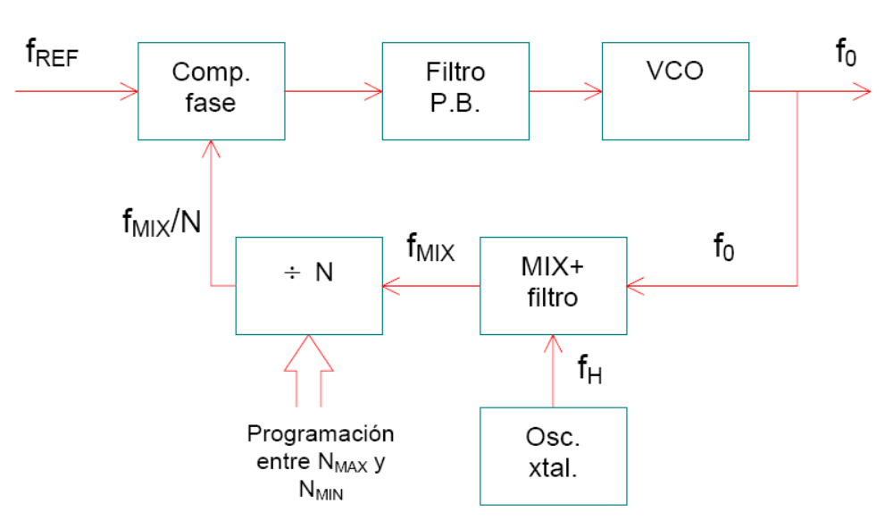
Conversión superheterodina
Notes:
Explain what TANGO is in a little more detail
Explain what an ontology is – a conceptual representation of data

Slide 4
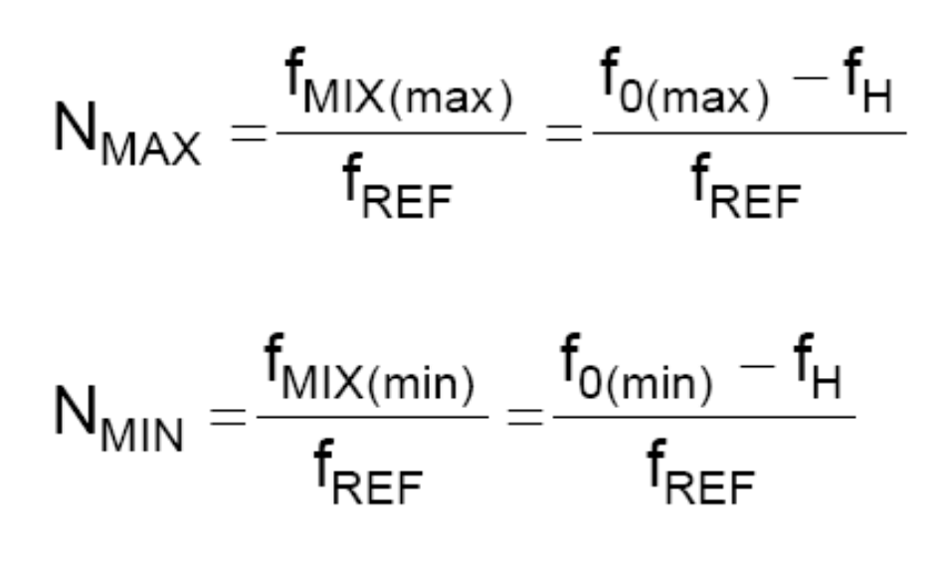
Notes:
Explain what TANGO is in a little more detail
Explain what an ontology is – a conceptual representation of data

Slide 5
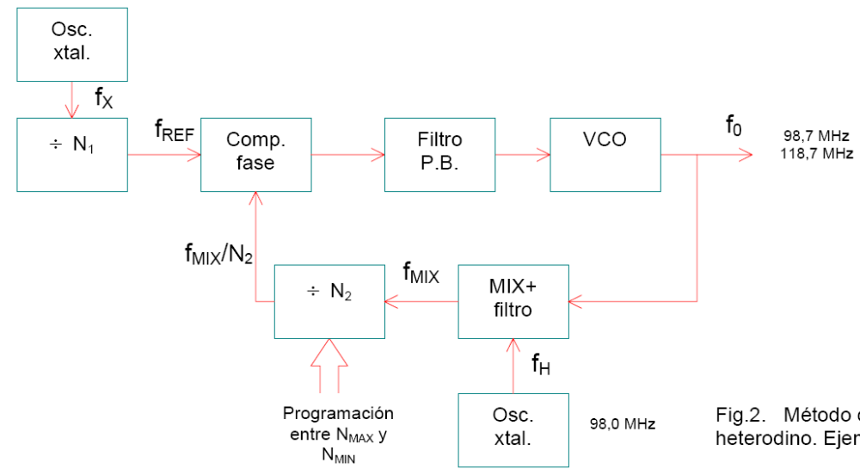

Ejemplo:
Notes:
Explain what TANGO is in a little more detail
Explain what an ontology is – a conceptual representation of data

Slide 6
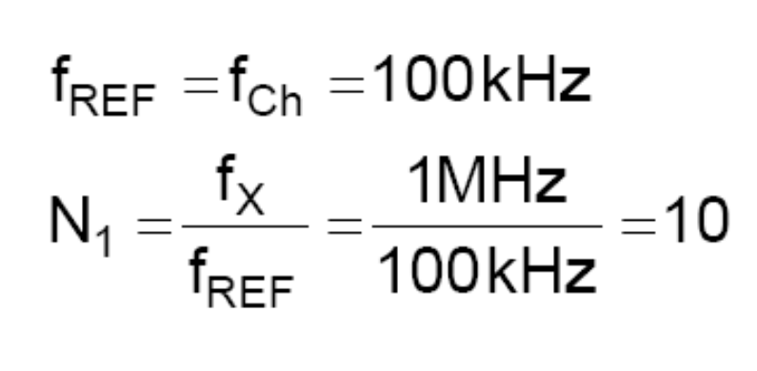
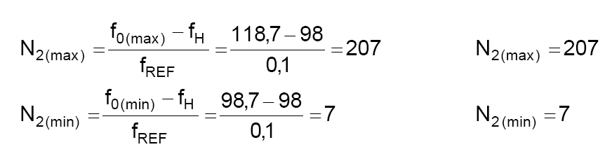
Ejemplo:
Notes:
Explain what TANGO is in a little more detail
Explain what an ontology is – a conceptual representation of data

Slide 7
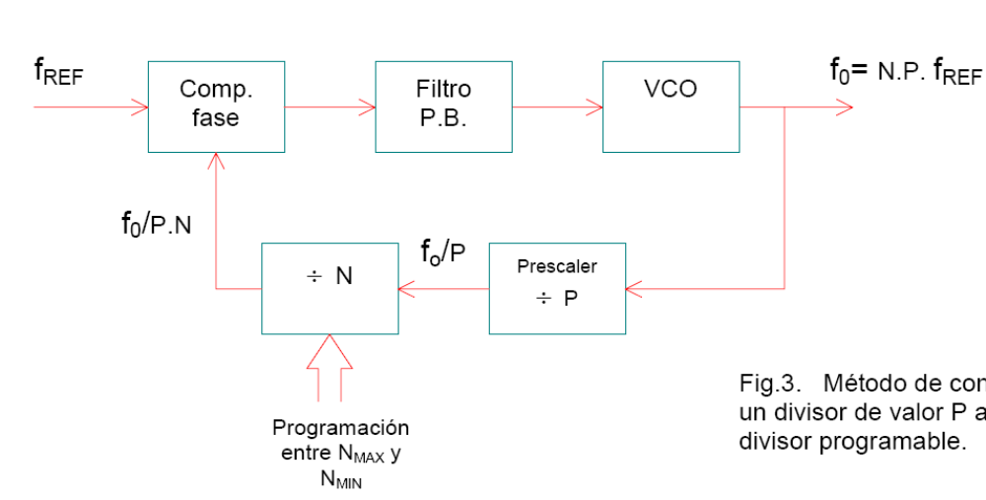
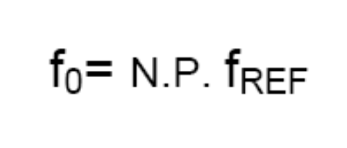
Preescaler
La frecuencia de salida es *P !!
Notes:
Explain what TANGO is in a little more detail
Explain what an ontology is – a conceptual representation of data

Slide 8
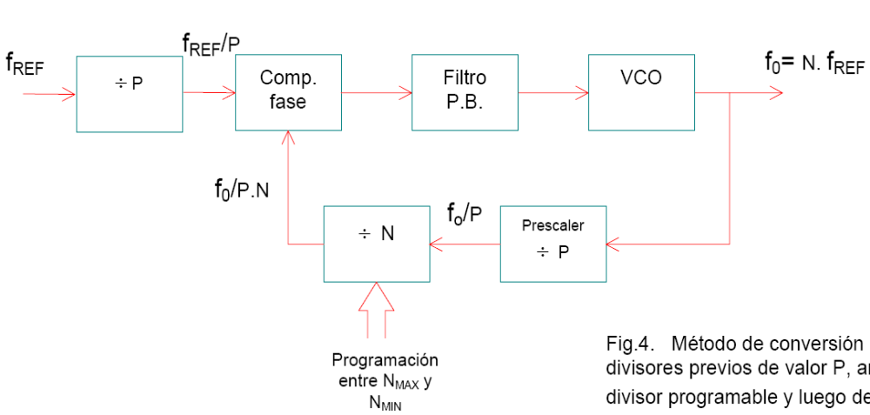
Preescaler
La frecuencia de control
es /P !!
Notes:
Explain what TANGO is in a little more detail
Explain what an ontology is – a conceptual representation of data

Slide 9
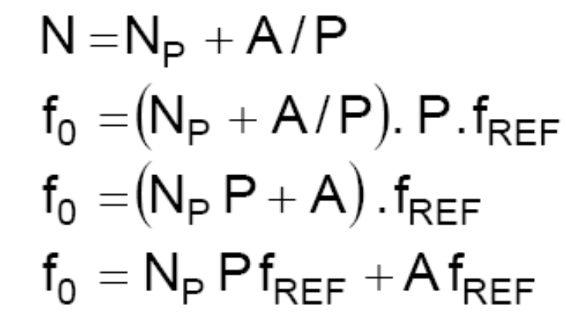
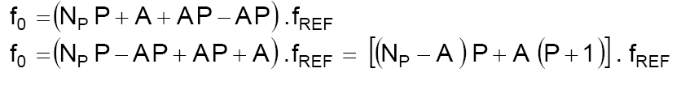
Preescaler
Notes:
Explain what TANGO is in a little more detail
Explain what an ontology is – a conceptual representation of data

Slide 10
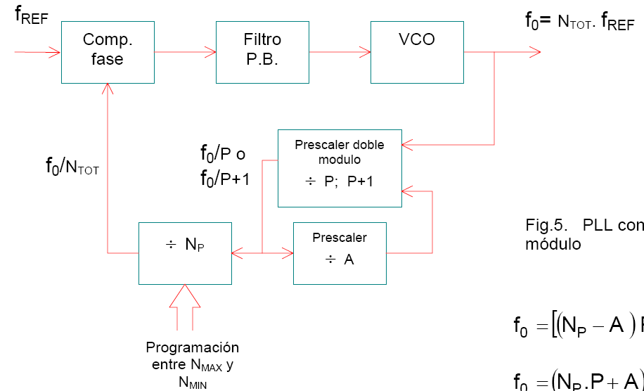
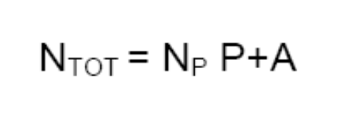
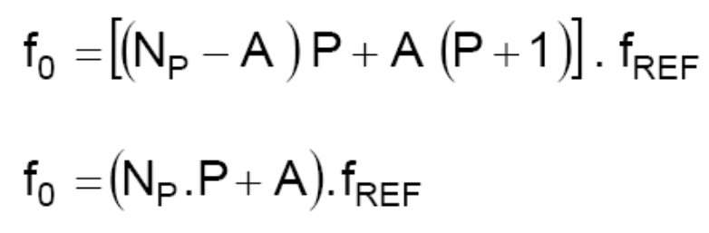
Notes:
Explain what TANGO is in a little more detail
Explain what an ontology is – a conceptual representation of data

Slide 11
Preescaler
El contador A cuenta desde el estado programado A
hasta el estado “enable”, y permanece en ese estado hasta que el divisor NP complete su conteo programado.
El prescaler divide por P+1 hasta que el contador A llega a cero.
Al final de (P+1), el estado de NP iguala a (NP-A), y el módulo del prescaler cambia a P.
Notes:
Explain what TANGO is in a little more detail
Explain what an ontology is – a conceptual representation of data

Slide 12
Preescaler
El contador A cuenta desde el estado programado A
hasta el estado “enable”, y permanece en ese estado hasta que el divisor NP complete su conteo programado.
El prescaler divide por P+1 hasta que el contador A llega a cero.
Al final de (P+1), el estado de NP iguala a (NP-A), y el módulo del prescaler cambia a P.
El prescaler dividirá por P por todo el conteo (NP-A) remanente, hasta que (NP-A) llega a cero.
Notes:
Explain what TANGO is in a little more detail
Explain what an ontology is – a conceptual representation of data

Slide 13
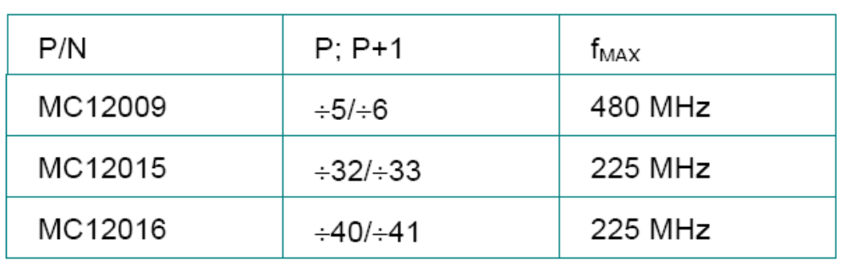
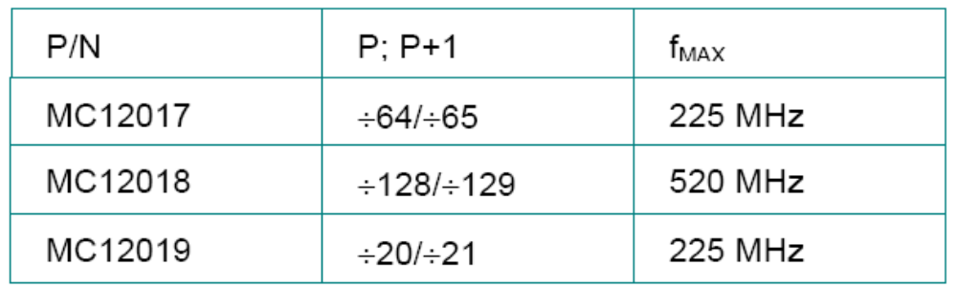
Preescaler de doble módulo
Notes:
Explain what TANGO is in a little more detail
Explain what an ontology is – a conceptual representation of data

Slide 14
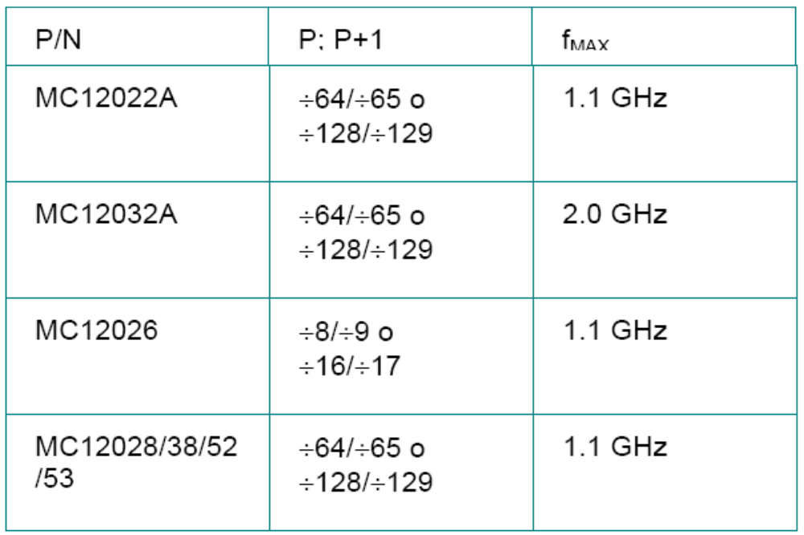
Preescaler doble módulo
Notes:
Explain what TANGO is in a little more detail
Explain what an ontology is – a conceptual representation of data

Slide 15
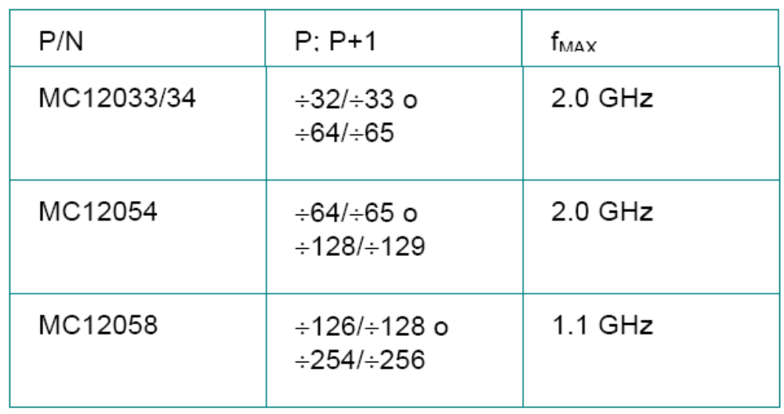
Preescaler doble módulo
Notes:
Explain what TANGO is in a little more detail
Explain what an ontology is – a conceptual representation of data

Slide 16
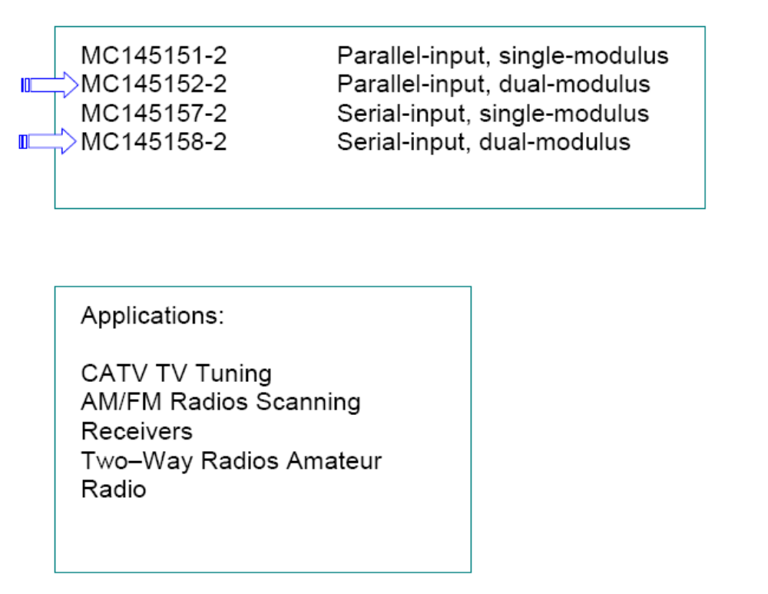
PLL con prescaler doble módulo Motorola
Notes:
Explain what TANGO is in a little more detail
Explain what an ontology is – a conceptual representation of data

Slide 17
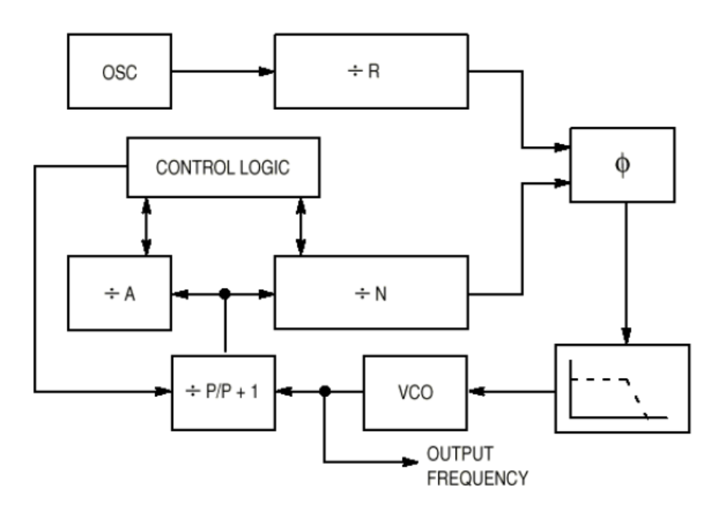
PLL con prescaler doble módulo Motorola
Notes:
Explain what TANGO is in a little more detail
Explain what an ontology is – a conceptual representation of data

Slide 18

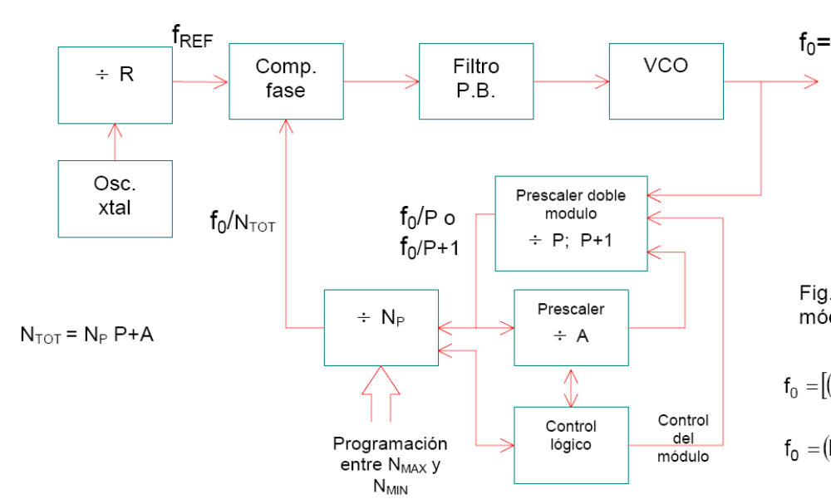
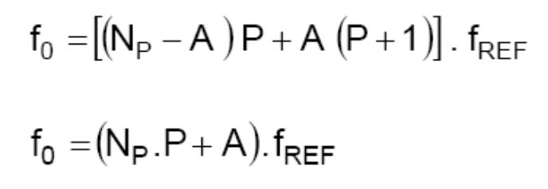
Diagrama en bloques práctico
Notes:
Explain what TANGO is in a little more detail
Explain what an ontology is – a conceptual representation of data

Slide 19
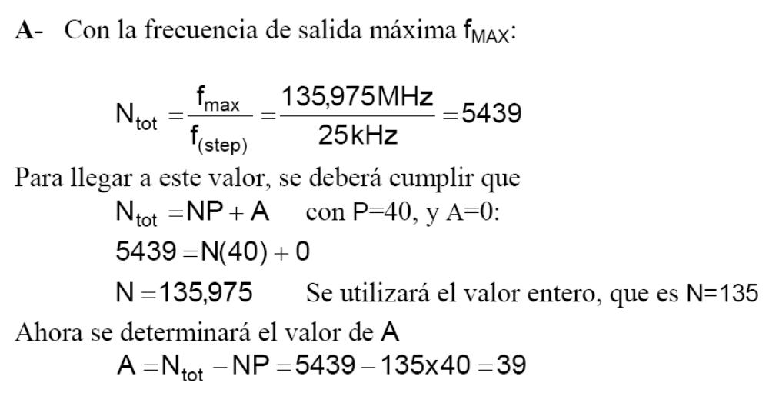
PLL de 118,000 a 135,975 MHz con saltos de 25 kHz
Notes:
Explain what TANGO is in a little more detail
Explain what an ontology is – a conceptual representation of data

Slide 20
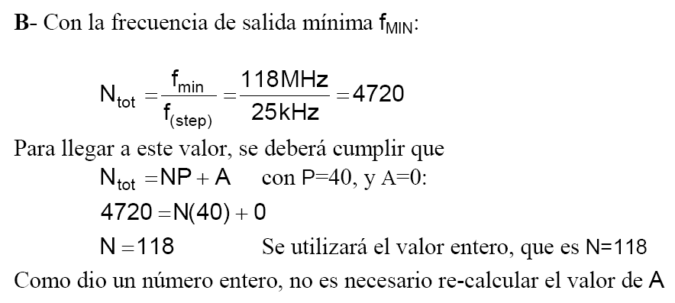
PLL de 118,000 a 135,975 MHz con saltos de 25 kHz
Notes:
Explain what TANGO is in a little more detail
Explain what an ontology is – a conceptual representation of data

Slide 21
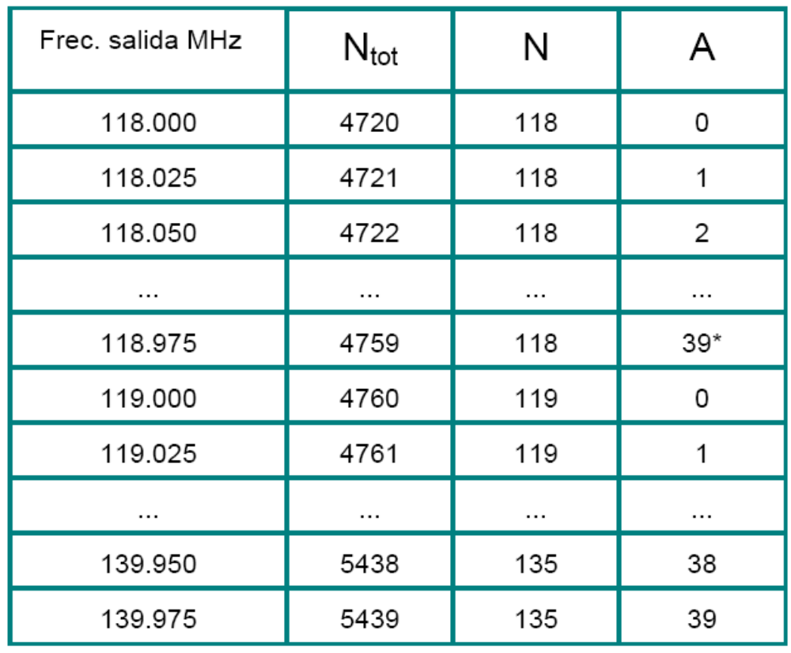
Valores de N y A
Notes:
Explain what TANGO is in a little more detail
Explain what an ontology is – a conceptual representation of data

Slide 22
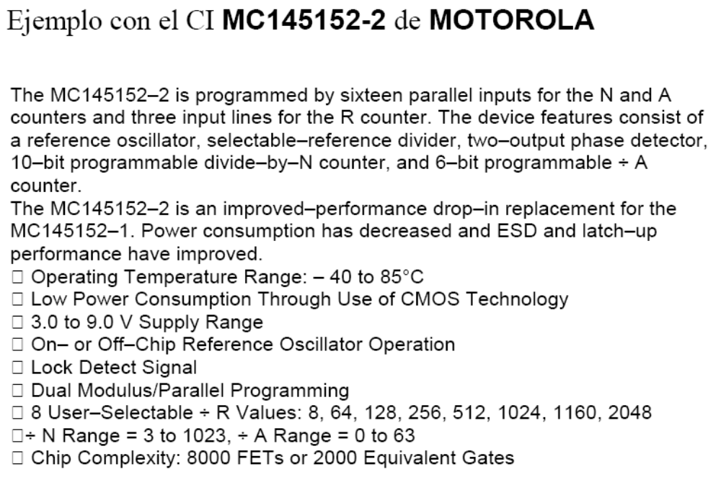
Notes:
Explain what TANGO is in a little more detail
Explain what an ontology is – a conceptual representation of data

Slide 23
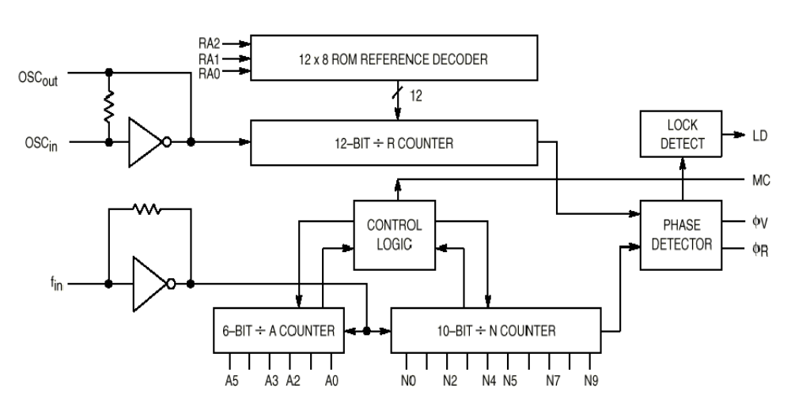
Diagrama en bloques
Notes:
Explain what TANGO is in a little more detail
Explain what an ontology is – a conceptual representation of data

Slide 24
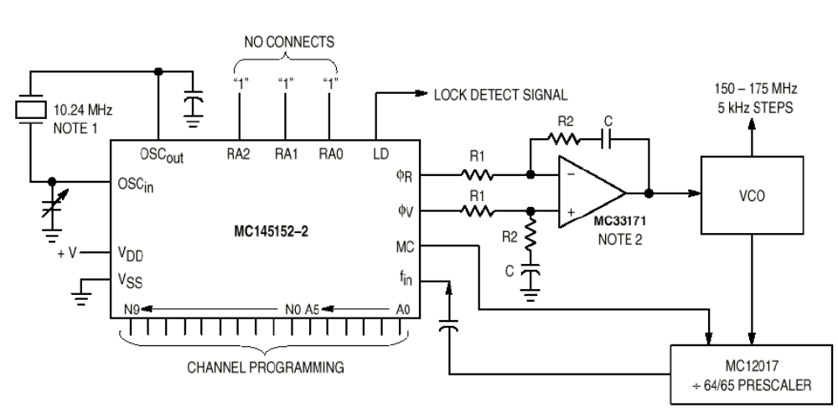
Ejemplo:
Notes:
Explain what TANGO is in a little more detail
Explain what an ontology is – a conceptual representation of data

Slide 25
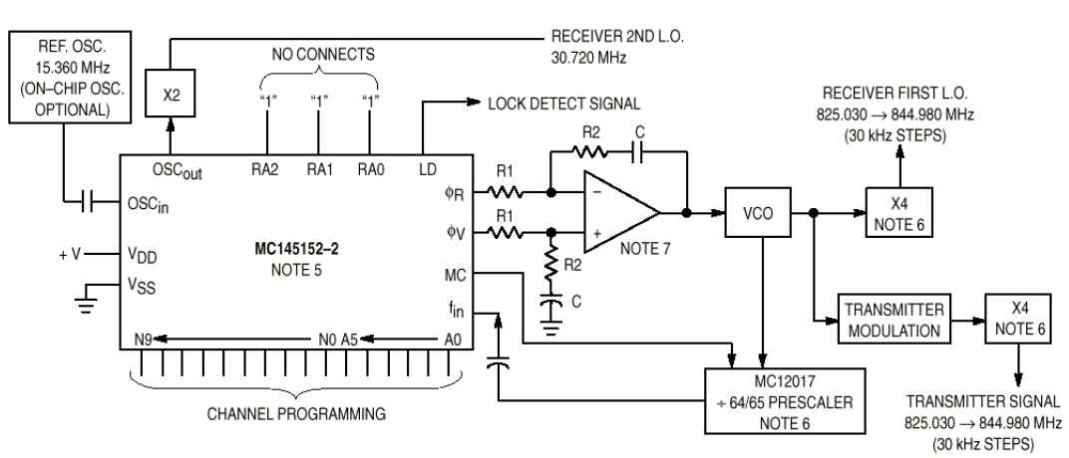
Ejemplo:
Notes:
Explain what TANGO is in a little more detail
Explain what an ontology is – a conceptual representation of data

Slide 26
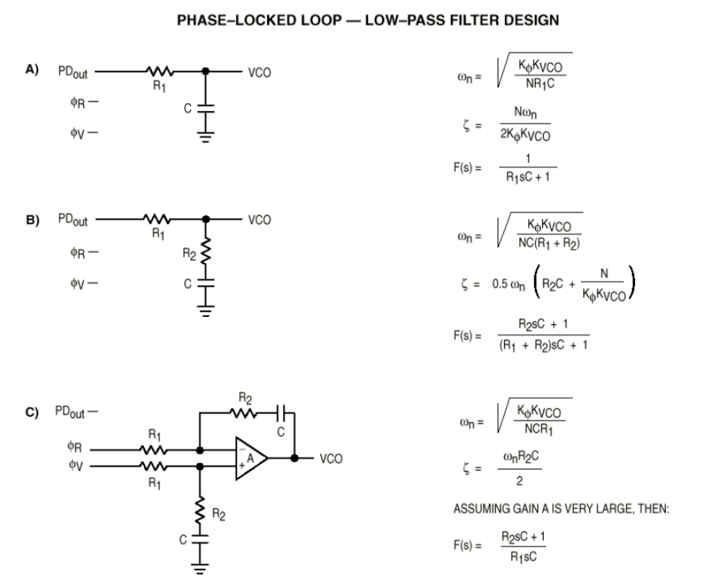
Diseño de los filtros:
Notes:
Explain what TANGO is in a little more detail
Explain what an ontology is – a conceptual representation of data

Slide 27
TP:
Se elige una aplicación en VHF o UHF
Se analiza el PLL a utilizar
Se elige el preescaler de doble módulo
Se incluye el diseño y cálculo del VCO y el filtro
Se completa el diseño
Conclusiones

